Slide 1
WHRC:
BARINGS FOUNDATION

Slide 2
How did I get here?
@STILLTish on Twitter
Parent of a Trans-identified Male (Gay)
ME: ADULT HUMAN FEMALE!

Slide 3
INSPIRED BY JENNIFER BILEK
WHO ARE THE FOUNDATIONS FUNDING GENDER IDENTITY IDEOLOGY?
WHY IS IT EVERYWHERE?
WHY ARE SO MANY OF OUR KIDS SAYING THEY ARE “TRANS”?

Slide 4
Foundations Funding Transgender Ideology THERE ARE MORE!
BARINGS FOUNDATION
ASTRAEA LESBIAN FOUNDATION
ARCUS FOUNDATION
OPEN SOCIETY FOUNDATION

Slide 5
FOCUS ON BARINGS FOUNDATION UK
BARINGS BANK BANKRUPTCY NICK LEESON
BARINGS FUND THE APPG LGBTQ IN UK PARLIAMENT
MONEY ROUTED VIA KALEIDOSCOPE TRUST
SECRETARIAL SERVICING JOINT WITH STONEWALL
THE PARLIAMENTARY RESEARCHER WAS FORMERLY A RESEARCHER FOR IGLYO (INTERNATIONAL LGBTQ GROUP FOR YOUTH AND STUDENT ORGANISATION
IGLYO WORKS BEHIND THE SCENES TO EMBED “GENDER IDENTITY” IN LAW.

Slide 6
DENTON’S REPORT : IGLYO
https://gendercriticalwoman.wordpress.com/2020/07/23/that-dentons-document/
IT’S BASICALLY A BLUEPRINT TO EMBED “GENDER IDENTITY” IN LAW BY STEALTH, AVOIDING PRESS COVERAGE
ATTACH GENDER IDENTITY TO “POPULAR CAUSES”.
A PRACTICE AKIN TO “FORCE-TEAMING”.
@PankhurstEM (Dr Em)

Slide 7
BARINGS FOUNDATION
Funded a Stonewall employee to work within UK government department (Department for International Development (DFID).
To ensure LGBT+ agenda was embedded in DFIDs work OVERSEAS

Slide 8
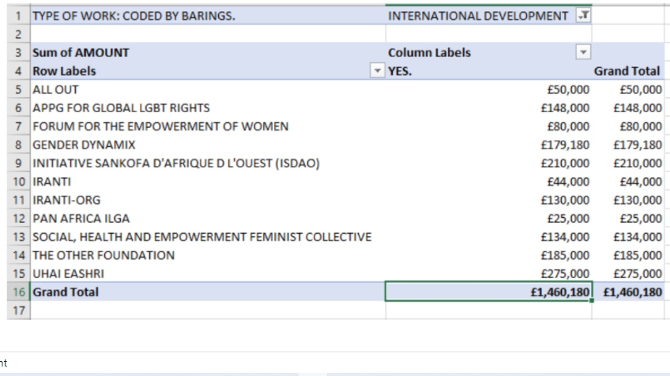

Slide 9
SOCIAL, HEALTH & EMPOWERMENT FEMINIST COLLECTIVE
S.H.E “African Transgender Women”
DEMANDED INCLUSION IN discussion on “women’s reproductive and sexual health rights”
S.H.E Hosted a Trans Diva Beauty Pageant
S.H.E believes “Contrary to popular belief, a sexual orientation is not solely based on sexual attraction”

Slide 10
NEO-COLONIALISM?
EMBEDDING GENDER IDENTITY IDEOLOGY GLOBALLY
PARTICULAR FOCUS ON FORMER UK COLONIES.

Slide 11
SOME QUESTIONS I TRY TO ANSWER
WHY IS TO MUCH ARCUS FUNDING GOING TO CHRISTIAN EVANGELICALS?
WHAT IS THE LINK BETWEEN BLACK LIVES MATTER AND TRANSGENDER IDEOLOGY?
WHY ARE THE GUARDIAN SO WOEFUL ON THIS TOPIC?
HOWIS THE MEDIA SUBJECT TO INFLUENCE FROM FOUNDATIONS?
WHAT IS THE LINK BETWEEN DISABILITY RIGHTS ACTIVISM AND RE-BADGING PROSTITUTION AS SEX WORK?
HOW DID REPRODUCTIVE JUSTICE FIGHTS GET USEB TO PUSH GENDER IDENTITY IDEOLOGY!
HOW MUCH MONEY IS GOING TO UNIVERSITIES?
HOW MUCH MONEY IS TO BE MADE FROM A GLOBAL INDUSTRY CREATING LIFELONG MEDICAL PATIENTS?

Slide 12
https://gendercriticalwoman.wordpress.com/2021/03/23/barings-foundation-1/
https://gendercriticalwoman.wordpress.com/2021/04/04/barings-foundation-2/
https://gendercriticalwoman.wordpress.com/2021/03/15/appg-on-lgbt-publication/
https://gendercriticalwoman.wordpress.com/2021/03/31/lesbian-gay-rights-in-african-countries/
https://gendercriticalwoman.wordpress.com/2021/04/10/astraea-lesbian-foundation/
https://gendercriticalwoman.wordpress.com/2021/04/22/arcus-foundation-grants/

Slide 13
My work
You can find me on twitter at @STILLTish
Blog:
https://gendercriticalwoman.wordpress.com/
  Research on “transgender medicine”.
  Who is being transitioned?
  Gay males, lesbians, autistic kids & “looked After” kids.
  Judicial cases
  Organisations promoting Gender Ideology e.g. Schools, Childline
  Charitable Foundations funding the institution of Transgender Ideology.
.

Slide 14
FINAL QUESTION
WHAT DID 17th Century SCOTS WITCH-FINDERS?
A COMMON-PRICKER
Thank you!
#WOMENWONTWHEESHT

