Slide 1
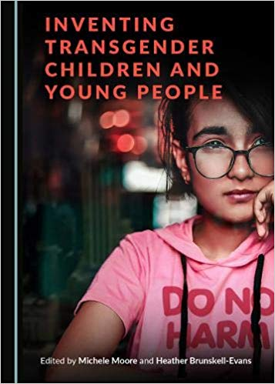
The Invention of the Transgender Child: A New Sex Education?
Sunday 27th October 2019.

Slide 2
The Invention of the Transgender Child: A New Sex Education?
10:00 – 10:45
Heather Brunskell-Evans: Gender Development Identity Services and the invention of ’The Transgender Child’.
10:45 – 11:30
Maureen O’Hara: Gender Ideology and Erosion of Child Safeguarding Principles.
11:45 – 12:30
Tracy Shaw, Safe Schools Alliance: Equality and Diversity Policy Red Flags in Schools (and what to do about them).
13:30 – 14:15
Stephanie Davies-Arai: The Transgender Child: The Creation of an Emblem for a Political Movement

Slide 3
The Invention of the Transgender Child: A New Sex Education?
14.15 – 15.00: Susan Matthews: How to Create a Gender Obsession.
15.00 – 15.15: Comfort Break
15.15 – 16.00: Charlie Evans: The Detransition Advocacy Network
16.00- 17.00: Plenary to elucidate actions to address coming changes to SRE.
Thanks, summary and close– move to bar/book launch!

Slide 4
The Invention of the Transgender Child: A New Sex Education?
10-10.45: Heather Brunskell-Evans: Gender Development Identity Services and the invention of ’The Transgender Child’. Gender identity medicine and transgender lobby groups inform each other in the construction of the ‘truth’ of children’s ‘transgender identity’. This politicised ‘truth’ bears no relationship to biological fact or progressive values yet forms a central pillar of the new Sex and Relationship Education.

Slide 5
The Invention of the Transgender Child: A New Sex Education?
10.45 -11.30: Maureen O’Hara: Gender Ideology and Erosion of Child Safeguarding Principles. Schools and other children’s services increasingly prioritise ‘gender identity’ over biological sex, and sex-based rights. Maureen will explore the ways in which the influence of gender ideology is leading professionals working with children to abandon child safeguarding principles, both in relation to children labelled ‘transgender’, and to other children.

Slide 6
The Invention of the Transgender Child: A New Sex Education?
11.45- 12.30: Tracy Shaw, Safe Schools Alliance: Equality and Diversity Policy Red Flags in Schools (and what to do about them). SSAUK is a national group of parents, teachers, governors and professionals dedicated to putting safeguarding at the heart of its activism. SSAUK will talk about how it is focused on working with schools and educators to ensure school policies meet the safeguarding needs of all students whilst taking into account the protected characteristics of the Equality Act.

Slide 7
The Invention of the Transgender Child: A New Sex Education?
13.30 -14.15: Stephanie Davies-Arai: The Transgender Child: The Creation of an Emblem for a Political Movement. The organisations who are influencing clinical practice and dictating guidance for schools are not neutral child support groups. Rather, they are political lobby groups who campaign to change society to fit an ideological agenda to replace sex with 'gender identity' as the distinction between men and women.

Slide 8
The Invention of the Transgender Child: A New Sex Education?
14.15 – 15.00: Susan Matthews: How to Create a Gender Obsession. This talk looks at the new genre of gender identity guides and workbooks - now available for readers from one to 101 - aimed both at school children and at professionals. Using the language of authenticity and self-knowledge, these books teach the doctrine of gender identity and encourage disassociation from the body.

Slide 9
The Invention of the Transgender Child: A New Sex Education?
15.15 – 16.00: Charlie Evans: The Detransition Advocacy Network

Slide 10
The Invention of the Transgender Child: A New Sex Education?
16.00- 17.00: Plenary to elucidate actions to address coming changes to SRE. Thanks, summary and close– move to bar/book launch!

Slide 11
The Invention of the Transgender Child: A New Sex Education?
“This book makes a major contribution to the understanding of the phenomenon of transgenderism and gender dysphoria. It will be a key reference work for many years to come.”
David Bell, Psychoanalyst and Consultant Psychiatrist, Tavistock and Portman NHS Foundation Trust.
Available to buy today at a 20% discount

Slide 12
10-10.45: Heather Brunskell-Evans: Gender Development Identity Services and the invention of ’The Transgender Child’. Gender identity medicine and transgender lobby groups inform each other in the construction of the ‘truth’ of children’s ‘transgender identity’. This politicised ‘truth’ bears no relationship to biological fact or progressive values yet forms a central pillar of the new Sex and Relationship Education.

Slide 13
Article in Today’s Times
https://www.thetimes.co.uk/edition/news/parents-battle-state-sponsored-sterilisation-of-trans-children-mb55fxt60

