Slide 1
Schools Equality and Diversity Policy
Red Flags
Presenter: Tracy Shaw
27 October 2019

Slide 2
About me
Mother of two girls, radicalized by MumsNet
Appalled by British Gymnastics Transgender policy
Incensed by daughters school Transgender policy
Inspired by the street campaigning during the GRA consultation
Disgusted with Oxfordshire County Council’s (less than transparent and lengthy) review process
Encouraged by the engagement and the following SSAUK has garnered
Proud to be talking on their behalf today

Slide 3
Background
Decided to form a bigger group:
We exploded on to the scene: NSPCC and Munroe Bergdorf. We were not quite ready for that….
Small groups had formed to challenge schools and LEAs
Groups had some success with Oxford and Warks (still ongoing). Oxon used the name “Safe Schools Alliance”
SSAUK Launched in June 2019
nurture grassroots activism
challenge decision makers at national level

Slide 4
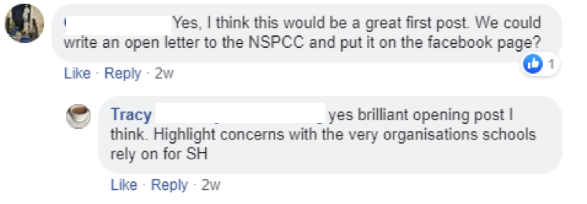
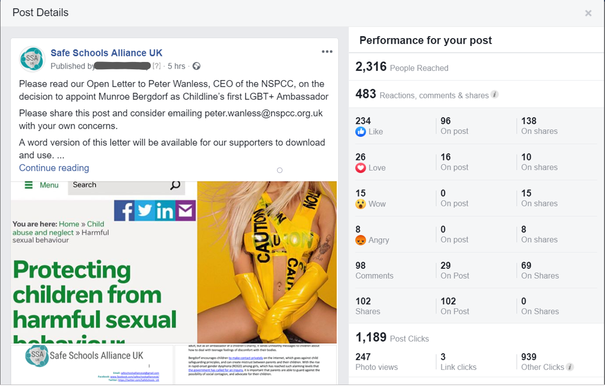
This is how it started…..
After just 4 hours….

Slide 5
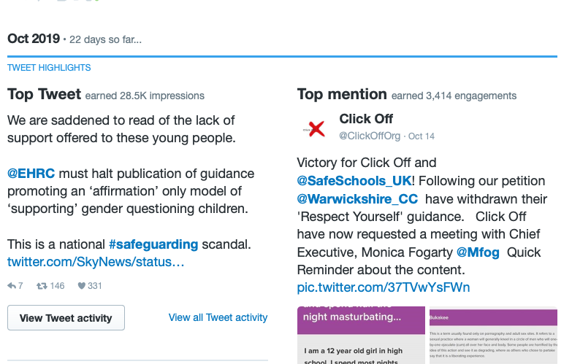
5 Months on…..

Slide 6
Who are we?
Managed by a small strategy group, a mixture of teachers, governors, parents and other professionals
We are non political, non religious and not aligned with any other organisation
Supported by an action group of parents and professionals. We have no funding, all volunteers

Slide 7
Our Misson
We are focussed on working with schools and educators to ensure that school policies meet the safeguarding needs of all students whilst taking into account the protected characteristics of the Equality Act 2010.
We endeavour to provide clarity on the law and offer unbiased, evidence-based guidance and support where conflict between protected characteristics arises.
Safe Schools Alliance UK strongly believes that the physical, mental and emotional well-being of children is paramount. We put Safeguarding first

Slide 8
Current campaigns
EHRC campaign
GIDS letter
Respect Yourself petition
Templates, letters, factsheets and other resources
Coverage in national papers
Distributing CRIA (Helen Saxby)
Local action challenging policy and RSE

Slide 9
Red Flags

Slide 10
Only citing lobby groups as a source of expertise
Referring to ‘gender’ as a protected characteristic
Not mentioning equality impact assessments
Advocating confidentiality for trans identified pupils
Promoting mixed-sex or ‘gender neutral’ toilets

Slide 11
Using emotive suicide statistics to put pressure on schools
Suggesting that all gender nonconformity indicates a child is trans
Making scientifically inaccurate assertions regarding biology
Delivering sessions to pupils without school staff present
Neglecting to disclose the negative side effects of transition

Slide 12
What to do about the Red Flags in your school
Use our template letter to write to your school. Include the head teacher, Chair of Governors and Safeguarding lead.
Use our Red Flags document (and other factsheets) to back up your concerns
Ask to see their Impact Assessment on any policy in place (they probably won’t have one but they should).
Share the CRIA (written by Helen Saxby, available on Transgender Trend website) on the Allsorts guidance (even if its not by Allsorts it will have similar points)
Ask for a meeting – print off the red flags document and take it with you.

Slide 13
For increased impact take a fellow parent (form a RL group or join ours online)
Have alternative resources such as the Transgender Trend materials
Point out their legal obligations
Ask for a reasoned response to your objections
Pursue a formal complaint if you do not get satisfactory answers
Don’t give up. This is a marathon not a sprint.

Slide 14
We need lots of people to…..
Talk to the SG lead
Be prepared to write a lot of letters
Find out what the policy is at your school
Talk to other parents
Share our posts
Follow us on Twitter and Facebook
Use our resources

Slide 15
Find us…
Twitter: SafeSchools_UK
Facebook: https://www.facebook.com/safeschoolsallianceuk/
Web: https://safeschoolsallianceuk.org

