Slide 2
Referrals to the Tavistock 1989 - 2017

Slide 4
GIRES supports the application of the term “sex” to biological factors and “gender” to psychosocial and cultural factors. Hence, male/female are terms for describing sex. Man/woman, or any variations between or outside these psychosocial categories, are terms for describing gender identity.'
(GIRES, Annual Report 2017)

Slide 5
Our Gender identity is our psychological sense of fitting into social categories, typically of 'man' or 'woman’
(GIRES elearning Gender Variance)

Slide 6
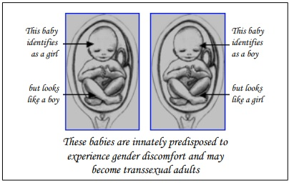

Slide 8
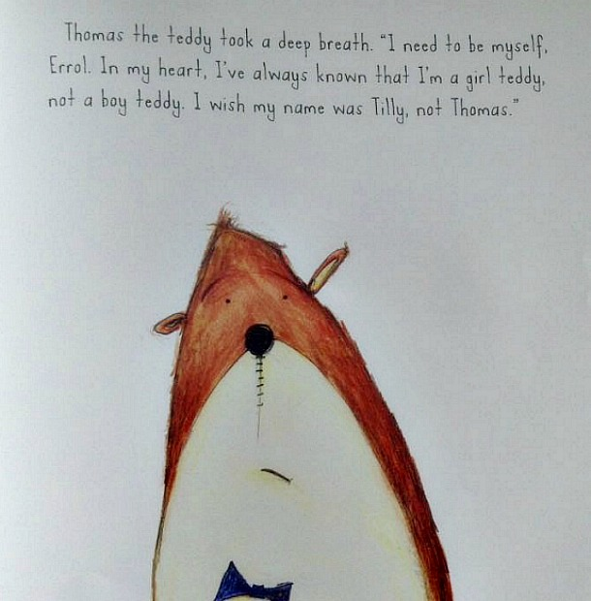

Slide 9
